Slide 1
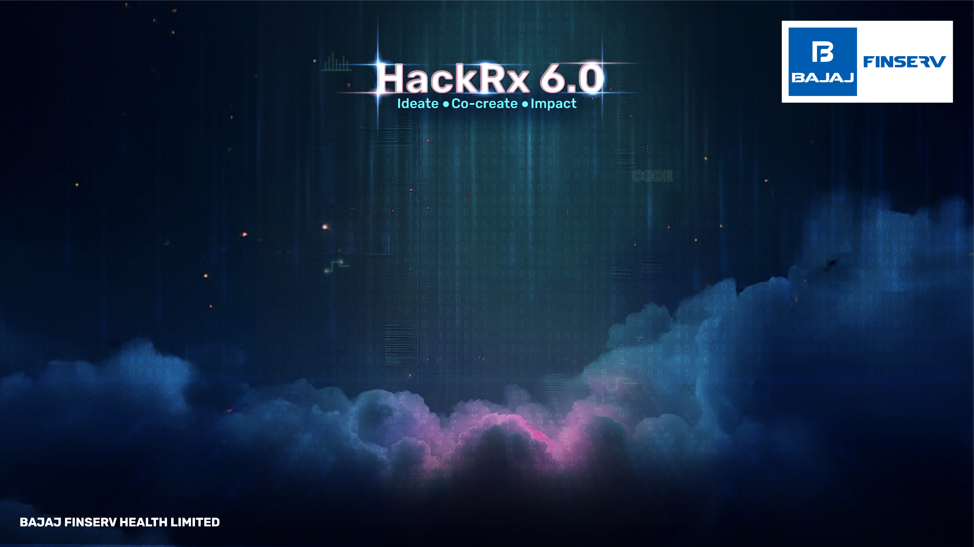
ROOT@HACKERS
Team members :
Sanjit V K
Sanjana R
Nischala K N
Monika K R
Prabhav G K
Graduating year : 2027
College Name : Vidyavardhaka college of Engineering

Slide 2
Tell us a bit about yourself
We are a team of Third-year engineering students passionate about AI, systems design, and solving real-world problems with intelligent automation.
Projects
Hackathon
Awards

Slide 3
Problem statement
Design an LLM-Powered Intelligent Query–Retrieval System that can process large documents and make contextual decisions. Your system should handle real-world scenarios in insurance, legal, HR, and compliance domains.
The primary use case is to build a powerful customer-facing support tool for Bajaj Finserv, addressing problems such as
“OTP not received”
“Transaction failure”
“Does my policy cover knee surgery?”
“Transparency issues"

Slide 4
Tech Stack
🧩 Backend: Fast API 🧠 LLM: GPT-4 (via OpenAI API) 📦 Vector DB: Pinecone 🗃️ Relational DB: PostgreSQL ☁️ Cloud Services: Any cloud that supports Python + REST APIs (e.g., AWS, Azure) 🖥️ Frontend : Web chatbot / REST API

Slide 5
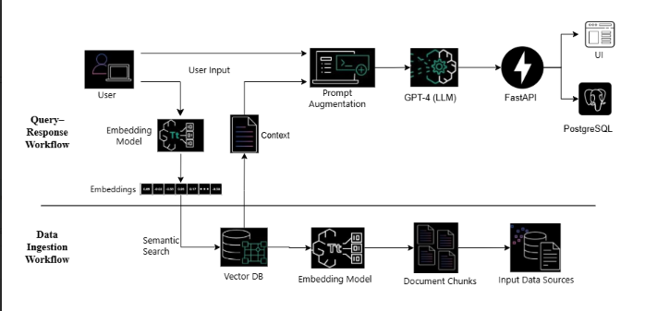
Detailed description of the solution

Slide 6
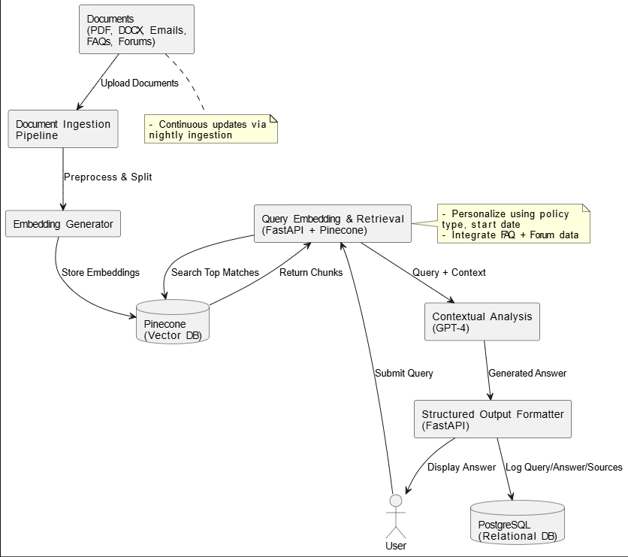
Data Flow Diagram

Slide 7
So, how if your solution different?
5x Smarter Than Chatbots: Not a rule-based bot, but a real-time semantic system
📚 Hybrid Knowledge: Combines official docs + forums + FAQs
👤 Personalization: Answers filtered by user’s actual policy
🔄 Always Fresh: Nightly data syncs prevent outdated info
🤖 Smart Escalation: Supports clarification dialogues & intelligent human escalation
Designed for scalability across domains beyond insurance

Slide 8
Future possible enhancements
Frontend dashboard for agents and customers
Multilingual support for regional language queries
Integration with call center IVRs
Automatic summarization of entire policies
Real-time analytics dashboard for support trends

Slide 9
Risks/Challenges/Dependencies
Challenge | Mitigation
1. LLM Hallucinations | Ground responses using retrieved context and cite sources to avoid fabricated answers.
2. High Latency (Real-Time Performance) | Pre-embed common queries, optimize Pinecone, and use async FastAPI for responsiveness.
3. Knowledge Obsolescence | Run nightly ingestion to update policy documents, FAQs, and community threads.
4. Policy Personalization Complexity | Inject user-specific metadata (e.g., plan type, start date) to personalize answers accurately.
5. Data Privacy & Compliance | Encrypt data, anonymize inputs, enforce access controls, and follow compliance standards.
6. GPT-4 API Dependency | Use fallbacks (e.g., cached responses), monitor usage, and explore open-source alternatives.
7. Multilingual Query Handling | Add translation layer and language tagging for support in local or mixed-language queries.
8. Enterprise Integration (e.g., Bajaj Systems) | Design modular APIs, follow OpenAPI standards, and create mock integration demos.
9. Escalation Misclassification | Use intent classification + feedback loop to ensure smooth handoff to human agents when needed.

Slide 10
Acceptance Criteria Coverage
Query intent analysis
Semantic search & context retrieval
LLM-powered contextual generation
Policy-specific personalization
Logging & traceability (compliance-friendly)
Domain extensibility
Handles real-world support cases
Support for complex documents (PDFs, legal)
Combines internal + external knowledge
System logs all responses (compliance-friendly)

Slide 11
Anything Else?
Advanced Features & Innovation Highlights
1. Personalized Policy Guidance
Uses user-specific data (policy type, start date, etc.) to tailor responses
Dynamically filters clauses based on individual plan details
Enables context-aware answers like waiting periods or coverage limits
2. Hybrid Knowledge Integration
Indexes not only official documents but also FAQs, support tickets, forums, and social threads
Retrieves real-world resolutions to uncommon or undocumented issues
Bridges the gap between formal policy and actual user experience

Slide 12
3. Continuous Knowledge Updates
Automatically ingests new policy versions, FAQs, and support logs.
Keeps the system up-to-date without needing model retraining.
Ensures relevance in fast-evolving customer support environments.
4. Clarification Dialogues & Escalation
Detects negative sentiment, repeated queries, or unclear intent.
Initiates follow-up questions or context-seeking dialogue.
Escalates complex cases to human agents with summarized context.

Slide 13
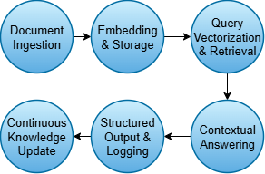
Process Flow

